Slide 1
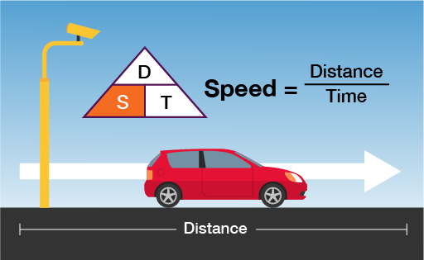
Time(t) / speed(s) / distance(d)
Different speed to know
Speed
Average speed
Relative speed
Effective speed

Slide 2
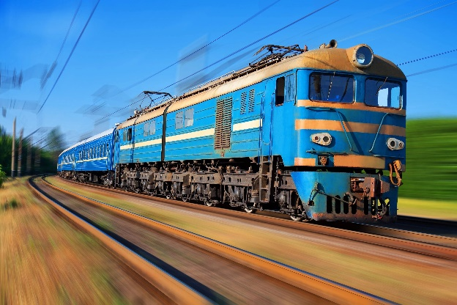
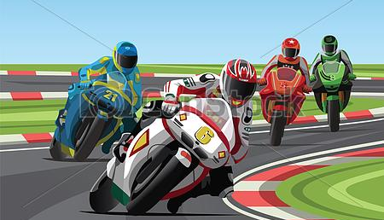

Types of problems that can be asked under this particular topic
Problems on trains
Boats & streams
Races & Games

Slide 3
Major unit conversions
Time:
1 hour = 60 minutes = 3600 seconds
To convert hour to minutes multiply by 60 / to convert hours to seconds multiply by 3600
Distance:
1 kilometer (Km) = 1000 meter (m)
To convert Km to m multiply by 1000/ to convert m to km divide by 1000

Slide 4
Major unit conversions
Speed (S):
Kmph & m/seconds
To convert kmph to m/seconds (m/sec)
X km/hr = x * (5/18) m/sec
To convert m/sec to kmph
X m/sec = x * (18/5) kmph

Slide 5
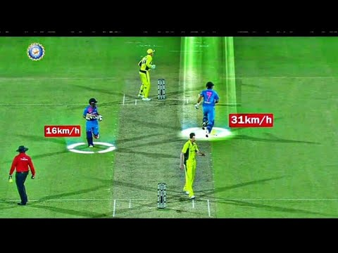
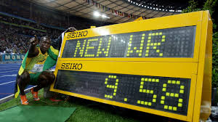
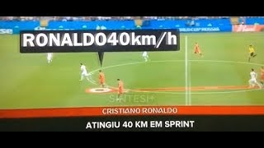
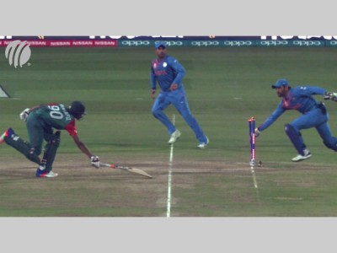

Slide 6
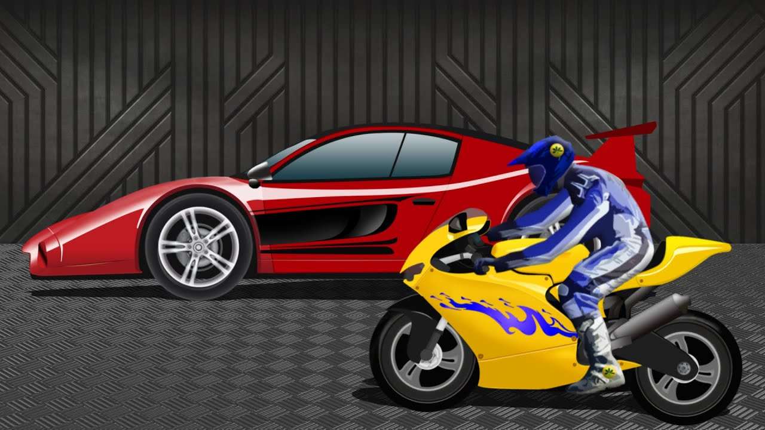
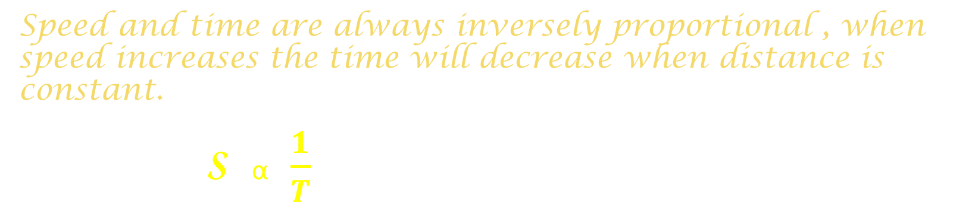
Relationship between speed and time
Speed and time are always inversely proportional , when speed increases the time will decrease when distance is constant.
S α $\frac{1}{T}$
Example , To cover a distance of 200 km if the speed of the car is 80 kmph , speed of the bike is 50 kmph.
Then
Car will take 200/80 = 2.5 hours to cover the distance
Bike will take 200/50 = 4 hours
So speed ratio of car and bike is 8:5
But time taken ratio will be 5:8

Slide 7

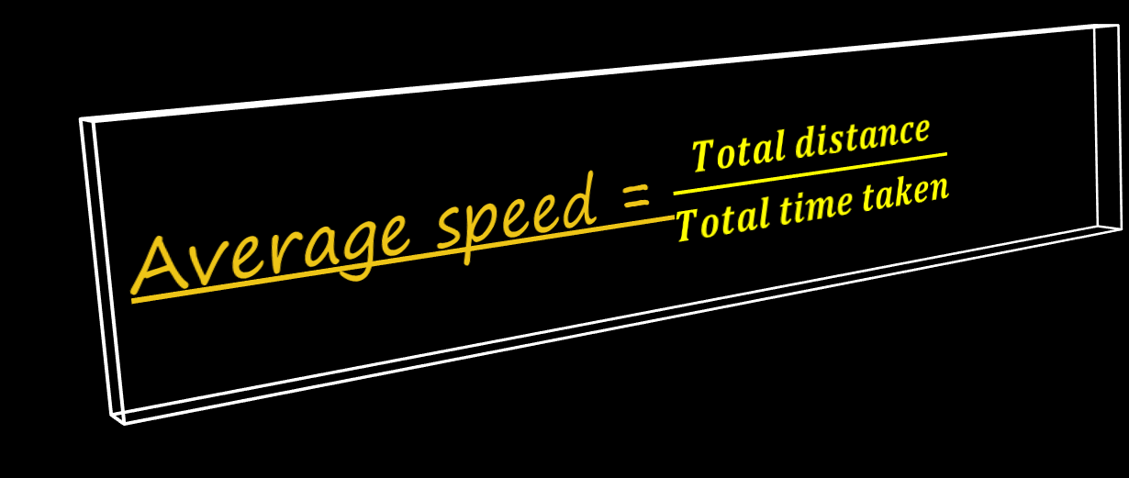
Average Speed
d1
d2
d3
Average speed = $\frac{Total distance}{Total time taken}$
‘a’ kmph
‘b’ kmph
‘c’ kmph

Slide 8
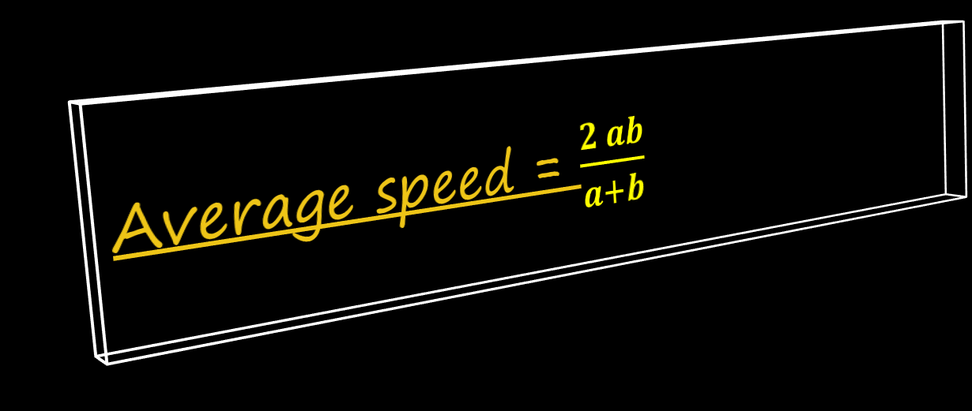
Average Speed- when distance is constant
d
d
‘a’ kmph
‘b’ kmph
Average speed = $\frac{2 ab}{a+b}$
60 kmph

Slide 9
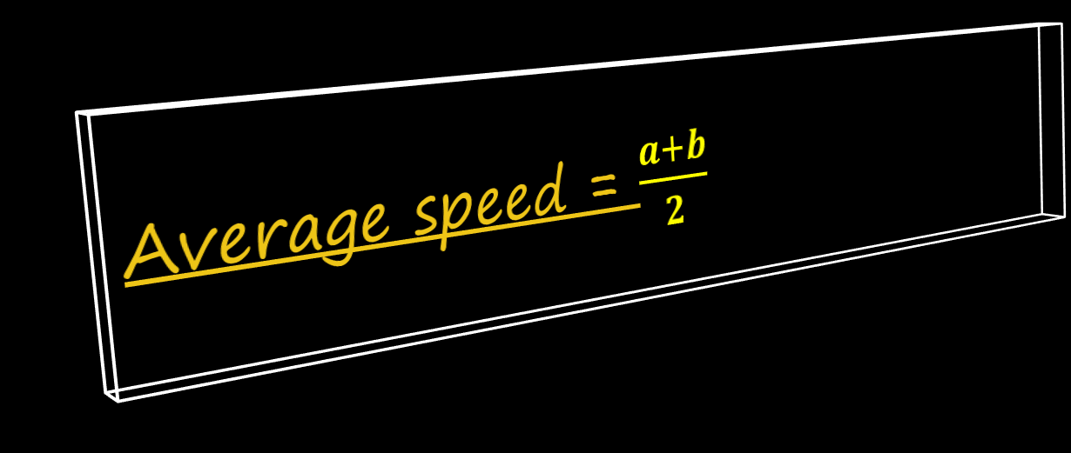
Average Speed – when time taken is constant
T hours
T hours
‘a’ kmph
‘b’ kmph
Average speed = $\frac{a+b}{2}$
60 kmph

Slide 10



Relative speed – Problems based on trains/ two objects moving simultaneously in same direction or opposite direction
When two objects move in same direction then
Relative speed (R.S) = S1- S2
s1= speed of faster object
S2 = speed of slower object
When two objects move in opposite direction then
Relative speed (R.S) = S1+ S2
s1= speed of faster object
S2 = speed of slower object

Slide 11
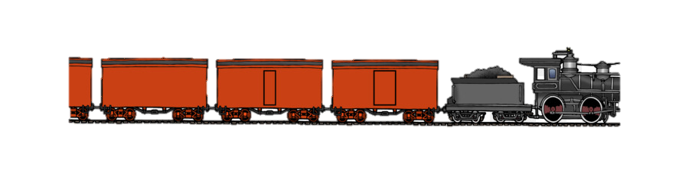
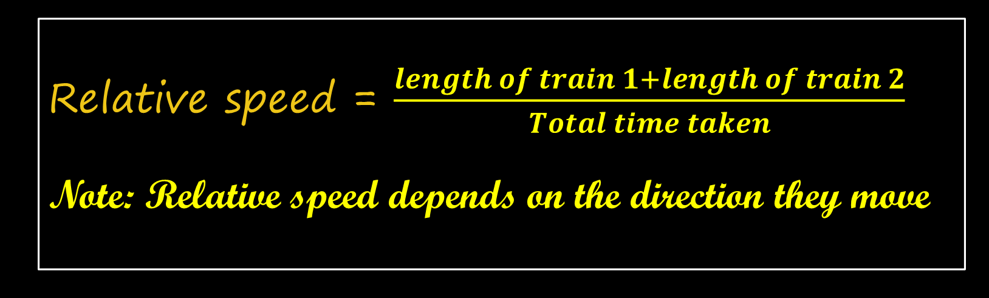
Problems on trains- major four cases
Case 1: Two trains crossing each other
Relative speed = $\frac{length of train 1+length of train 2}{Total time taken}$
Note: Relative speed depends on the direction they move

Slide 12
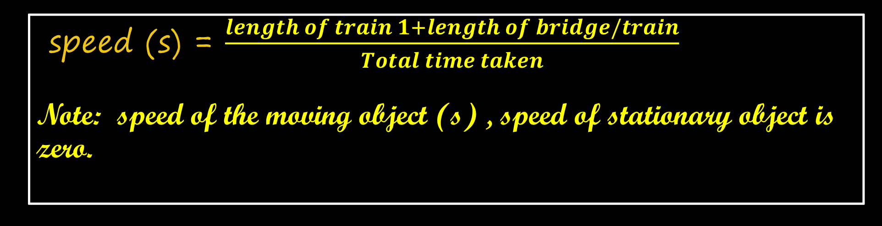
Problems on trains- major four cases
Case 2: Two objects considered where one object is moving and other is stationary. Example: Train crossing platform, Train crossing Bridge, Train crossing a stationary train.
Platform/Bridge / Train
Platform/Bridge / Train
speed (s) = $\frac{length of train 1+length of bridge/train}{Total time taken}$
Note: speed of the moving object (s) , speed of stationary object is zero.

Slide 13


Problems on trains- major four cases
Case 3: Two objects crossing each other, where one has negligible length & other has a definite length, eg: train & man, train&bird, etc
Relative speed = $\frac{length of train }{Total time taken}$
Note: Relative speed depends on the direction they move

Slide 14

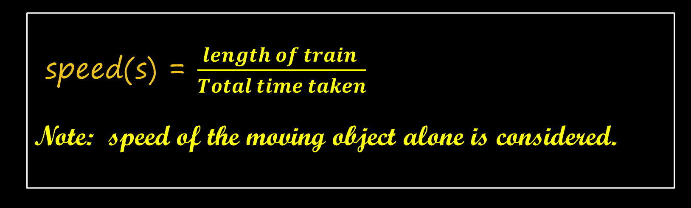
Problems on trains- major four cases
Case 4: Two objects crossing each other, where one has negligible length & other has a definite length, eg: train & man, train&bird, etc
speed(s) = $\frac{length of train }{Total time taken}$
Note: speed of the moving object alone is considered.

Slide 15
Bunti travels at a speed of 20 Kmph. After 5 hours, Bubli starts from the same point and travels towards Bunti, at a speed of 40 Kmph. What is the distance Bunti would have run, before Bubli catches up
with him?
Bb
Bt
Distance covered by Bunti = 20 * 5 = 100 km
Distance between Bunti and Bubli is 100 Km
40 Kmph
20 Kmph
Time taken by bubli to catch bunti
=100/20
= 5 hours
In that 5 hours Bubli would have travelled
= 5*40
= 200 km

Slide 16
A Policeman observes a thief running at a speed of 60 kmph when the distance between them is 400m. The policeman started chasing him at the speed of 72 Km/hr. In what time will the policeman catch the thief?
A. 120 seconds B. 130 seconds C. 150 seconds D. 60 seconds
Distance between Policeman and thief is 400 m
Relative speed between thief and policemen
= 72 – 60 = 12 kmph (same direction)
Police
400 m
Thief
72 Kmph
60 Kmph
Time taken by policeman to catch bunti
=0.4/12
= 1/30 hours
To convert hours to seconds
= (1/30) * 3600
= 120 seconds

Slide 17
Walking at 6/7 th of his usual speed, a man is 20 minutes too late. What is the usual time taken by him to cover that distance?
Let the usual time taken be ‘t’ & usual speed be ‘s’
If the speed is ‘6/7 s’ then time taken is ‘t+20’
We know distance is same here
S * t = (6/7) s * (t+20)
7t = 6t + 120
T = 120 minutes
= 2 hours

Slide 18
Travelling at 3/7 th of his usual speed, a person is 24 minutes late in reaching his office. Find the usual time taken by him to cover this distance.
A. 14 minutes B. 22 minutes C. 30 minutes D. 18 minutes
Let the usual time taken be ‘t’ & usual speed be ‘s’
If the speed is ‘3/7 s’ then time taken is ‘t+24’
We know distance is same here
S * t = (3/7) s * (t+24)
7t = 3t + 72
4t = 72 minutes
t = 18 minutes

Slide 19
A boy starts from his home at 25 kmph and reaches school 20 minutes late. If he would have walked at 40 kmph he would have reached 10 minutes early. Find the distance between school and home.
A. 90 km B. 75 km C. 43.33 km D. 33.33 km
Let the usual time taken be ‘t+20’ & usual speed be ’25 kmph’
If the speed is ’40 kmph’ then time taken is ‘t-10’
We know distance is same here
25 * (t+20) = 40 * (t-10)
5t + 100 = 8t -80
3t = 180
t = 60 minutes
Distance = speed * time
= 25* (80/60) [since speed in kmph and time in minutes converted time to hour]
= 25 * (4/3)
= 100/3
= 33.33 km

Slide 20
Saroj reaches his office 2 hours late by travelling at 40 kmph from his home. When he increases the speed to 60 kmph he is still late by 1 hour. What is the distance of his office from his home?
A. 180 km B. 110 km C. 120 km D. 150 km
Let the usual time taken be ‘t+2’ & usual speed be ’40 kmph’
If the speed is ’60 kmph’ then time taken is ‘t+1’
We know distance is same here
40 * (t+2) = 60 * (t+1)
2t + 4 = 3t + 3
t = 1 hour
Distance = speed * time
= 40* 3 or 60 *2
= 120 km

Slide 21
Sajan and Samir started their journey from Thane to Kalyan with speeds 24 kmph and 32 kmph respectively. If Samir reaches 35 minutes before Sajan, find the distance between Thane and Kalyan.
A. 56 km B. 74 km C. 114 km D. 128 km
Let the time taken by sajan be ‘t’ & usual speed be ’24 kmph’
If the speed samir is ’32 kmph’ then time taken is ‘t-(35/60)’
We know distance is same here
24 * (t) = 32 * (t – (35/60))
3t = 4t - (7/3)
t = 7/3 hr
Distance = speed * time
= 24* (7/3)
= 56 km

Slide 22

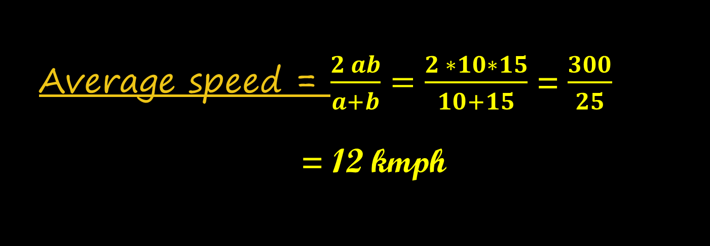
A student pedals from his home to college at a speed of 10 km/hr and back from the college to his home at 15 km/hr. What is
the average speed?
A. 14 km/hr B. 13 km/hr C. 12.5 km/hr D. 12 km/hr
d
d
Average speed = $\frac{Total distance}{Total time taken}$
‘a’ kmph
‘b’ kmph
Average speed = $\frac{2 ab}{a+b}=\frac{2 ∗10∗15}{10+15}$ = $\frac{300}{25}$
= 12 kmph

Slide 23
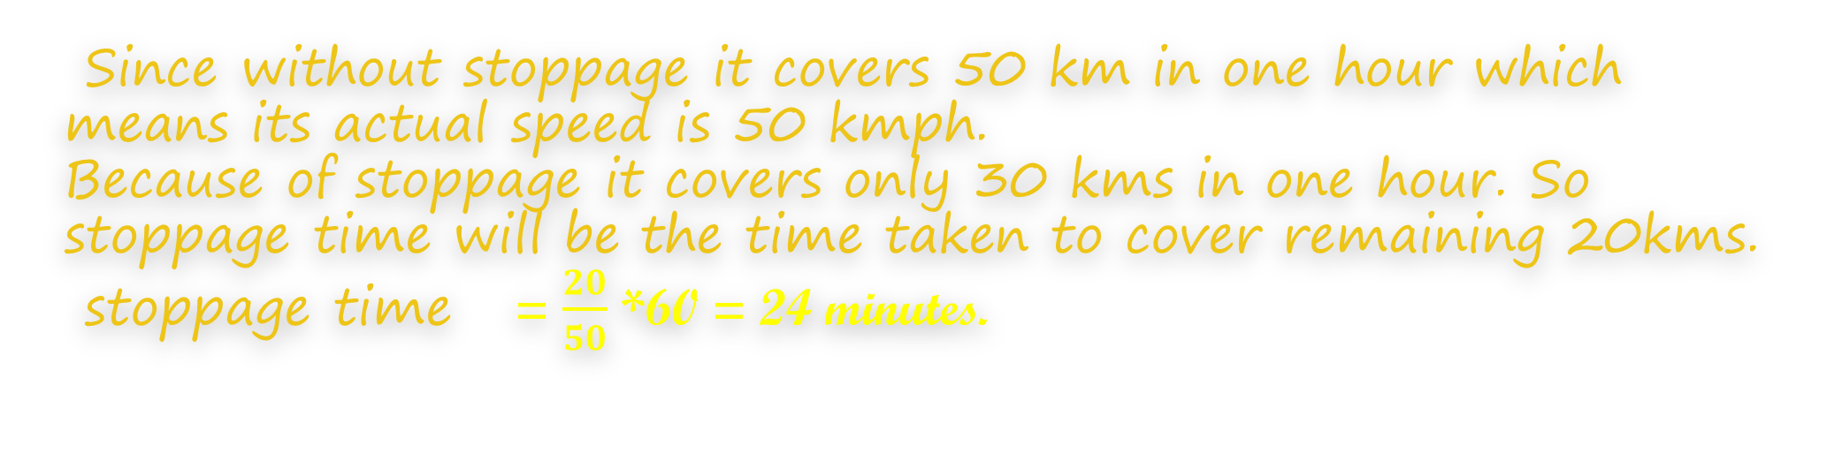
Without stoppages, a train can cover 50 kms in an hour. With stoppages it can cover 30 kms in an hour. Find its stoppage time per hour in a journey it covers with stoppages (in minutes)
A. 15 B. 18 C. 21 D. 24
‘50’ kmph without stoppage
‘30’ kmph with stoppage
Since without stoppage it covers 50 km in one hour which means its actual speed is 50 kmph.
Because of stoppage it covers only 30 kms in one hour. So stoppage time will be the time taken to cover remaining 20kms.
stoppage time = $\frac{20}{50}$ *60 = 24 minutes.

Slide 24
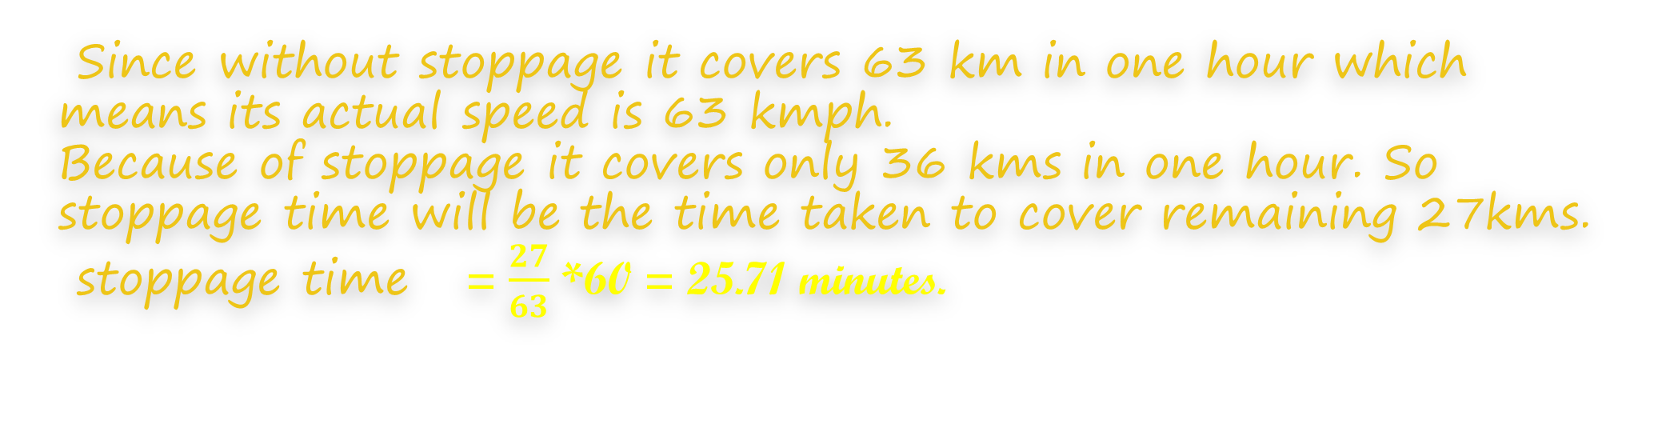
Excluding stoppage, the speed of a motorbike is 63 kmph & including stoppage it is 36 kmph. The number of minutes per hour for which the motorbike stops is
‘63’ kmph without stoppage
‘36’ kmph with stoppage
Since without stoppage it covers 63 km in one hour which means its actual speed is 63 kmph.
Because of stoppage it covers only 36 kms in one hour. So stoppage time will be the time taken to cover remaining 27kms.
stoppage time = $\frac{27}{63}$ *60 = 25.71 minutes.

Slide 25


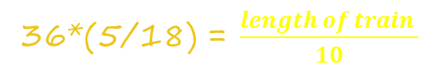

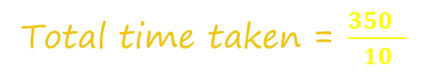
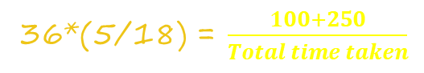
A train travelling at 36 kmph crosses a pole in 10 seconds. Find the time taken by this train to cross a platform which is 250m long?
A. 25 sec B. 30 sec C. 35 sec D. 40 sec
speed(s) = $\frac{length of train }{Total time taken}$
36*(5/18) = $\frac{length of train }{10}$
100 = length of the train
Platform/Bridge / Train
speed(s) = $\frac{length of train+length of the platform}{Total time taken}$
Total time taken = $\frac{350 }{10}$
36*(5/18) = $\frac{100+250}{Total time taken}$
Total time taken = 35 seconds

Slide 26
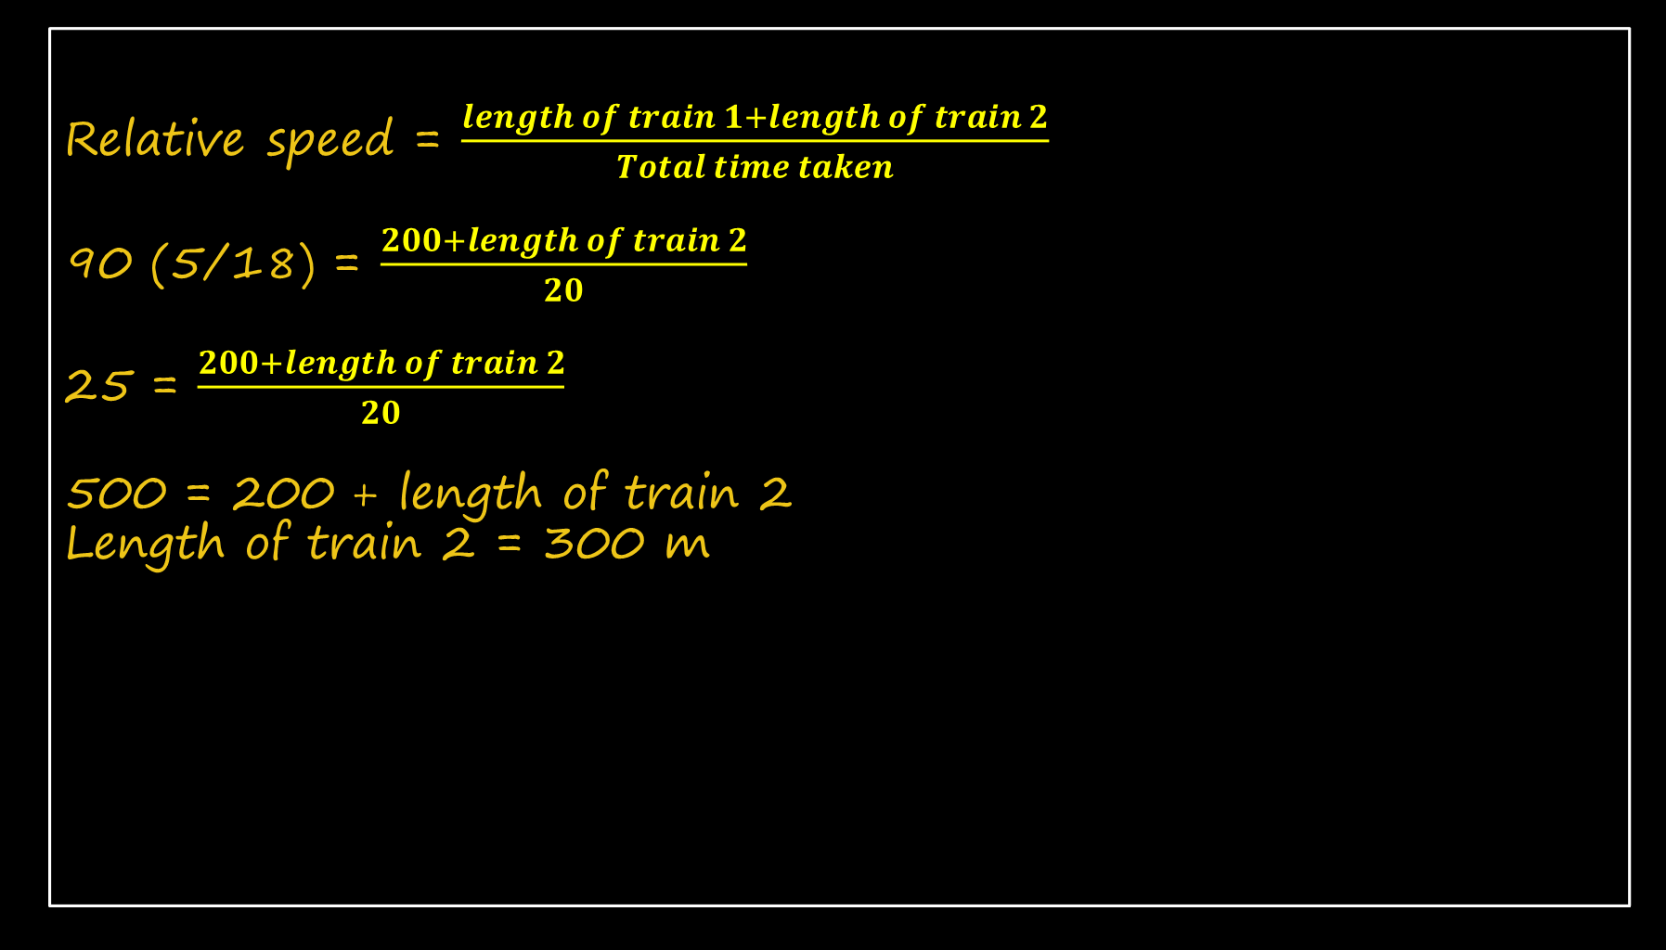
A train of length 200m running at a speed of 54 kmph crosses another train moving at a speed of 36kmph moving in a direction opposite to the former train in 20 seconds. What is the length of the second train?
A. 500 m B. 250 m C. 300 m D. Can’t say
Relative speed = $\frac{length of train 1+length of train 2}{Total time taken}$
90 (5/18) = $\frac{200+length of train 2}{20}$
25 = $\frac{200+length of train 2}{20}$
500 = 200 + length of train 2
Length of train 2 = 300 m

Slide 27

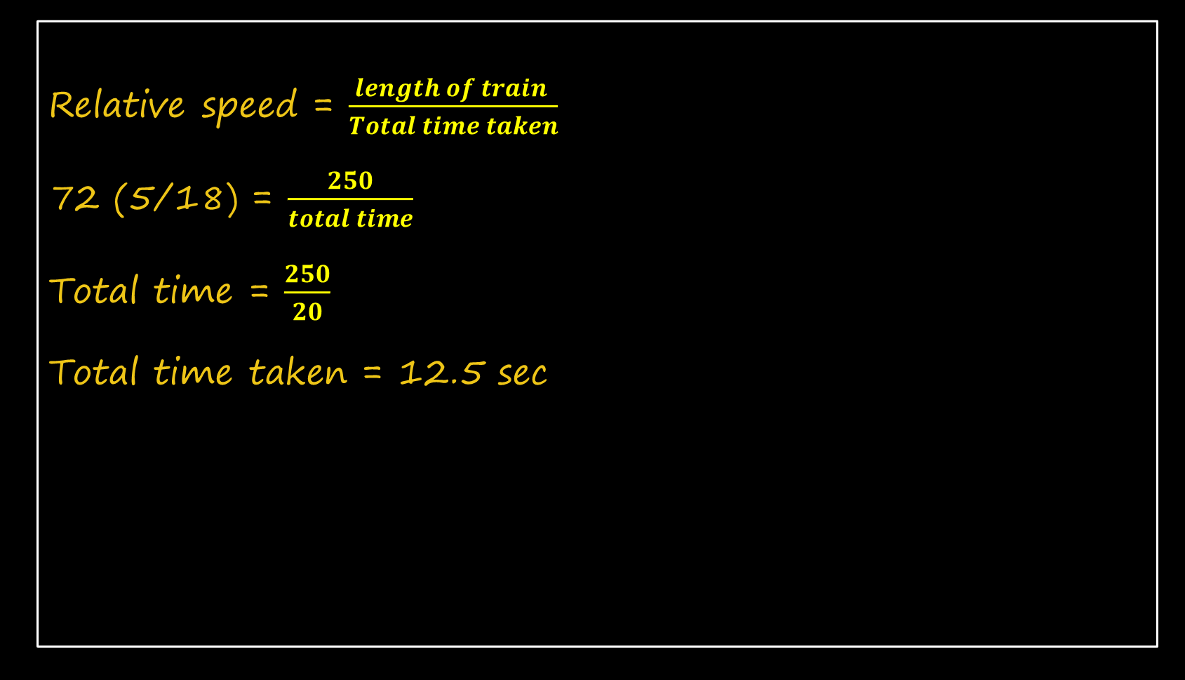
How long will a train of length 250m, running at a speed of 50kmph take to cross a man running in the opposite direction at a speed of 22 kmph?
A. 10 sec B. 12.5 sec C. 15 sec D. 17.5 sec.
Relative speed = $\frac{length of train }{Total time taken}$
72 (5/18) = $\frac{250}{total time}$
Total time = $\frac{250}{20}$
Total time taken = 12.5 sec

Slide 28
A train leaves a point A at 6 pm and reaches point B at 12 mid night. Another train leaves point B at 8 pm and reaches point A at 11 PM. At what time will these two trains meet?
A. 9.20 pm B. 9.30 pm C. 9.15pm D. 10.05 pm
6.00 P.M
8 km
8.00 P.M
4 km
8.00 P.M
Since Train 1 takes 6 hours / train 2 takes 3 hours ,
Lets assume the distance is 12 km
So speed of train 1 = 12/6 = 2 kmph
Speed of train 2 = 12/4 = 4 kmph
Distance covered by train 1 from 6 – 8 : 4 km
Meeting time = relative distance/ relative speed
= 8/6 = 4/3 * 60 = 80 minutes (1 hr 20 minutes)
Time = 1 hr 20 minutes after 8.00 A.M = 9:20 AM

Slide 29
BOATS AND STREAMS

Slide 30
A man rows downstream and covers 15 kms in 3 hours. He covers the same distance upstream in 5 hours. What is the difference in the distance travelled upstream in 10 hours and that downstream in 10
hours?
A. 18 kms B. 20 kms C. 25 kms D. 28 kms
DOWNSTREAM SPEED
Ds (Sb + Sc) = 15/3 = 5 Kmph
UPSTREAM SPEED
Us (Sb - Sc) = 15/5 = 3 Kmph
Upstream distance = 10 * 3 = 30 km
Downstream distance = 10 * 5 = 50 km
Difference = 50-30 = 20 km.

Slide 31
A boat can cover 40 kms downstream in 4 hours and 6 kms upstream in 3 hours. Find the time it would take to cover a round-trip journey between two points 20 kms apart?
A. 14 Hours B. 12 Hours C. 15 Hours D. 10 Hours
DOWNSTREAM SPEED
Ds (Sb + Sc) = 40/4 = 10 Kmph
UPSTREAM SPEED
Us (Sb - Sc) = 6/3 = 2 Kmph
Round trip means 20 km upstream & 20 km downstream
Upstream time = 20/2 = 10 hours
Downstream time = 20/10 = 2
Total time = 12 hours

Slide 32
A man can row 15kmph in still water and he finds that it takes him twice as much time to row up than as to row down the same distance in the river. The speed of the current (in kmph) is
A. 6 B. 6.5 C. 4.5 D. 5
Speed of the boat (Sb) = 15 kmph,
Speed of the current (Sc) = x
Let the time taken by downstream be t
Time taken by upstream be 2t
Both case distance is constant
(15+x) * t = (15 – x) *2t
15 + x = 30 – 2x
3x = 15
X = 5 kmph

Slide 33
A man can swim with the stream at the rate of 3 kmph and against the stream at the rate of 2 kmph. How long will it take him to swim 7 km in still water?
A. 3 h B. 2.8 h C. 2.6 h D. 3.2 h
Downstream speed (Ds)= 3 kmph,
Upstream speed (Us)= 2 kmph
Speed of the man (Sb) = 3+2/2 = 2.5 kmph
Time taken by man to cover 7 km in still water
= 7/2.5
= 70/25
= 14/5
=2.8 h

Slide 34
A boat covers a distance of 30 kms downstream in 2 hours while it takes 6 hours to cover the same distance upstream. What is the speed of the boat in kms per hour?
A. 10 B. 7.5 C. 13 D. 18
Downstream speed (Ds)
= 30/2
= 15 kmph
Upstream speed (Us)
= 30/6
= 5 kmph
Speed of the man (Sb) = 15+5/2
= 20/2
= 10 kmph

Slide 35
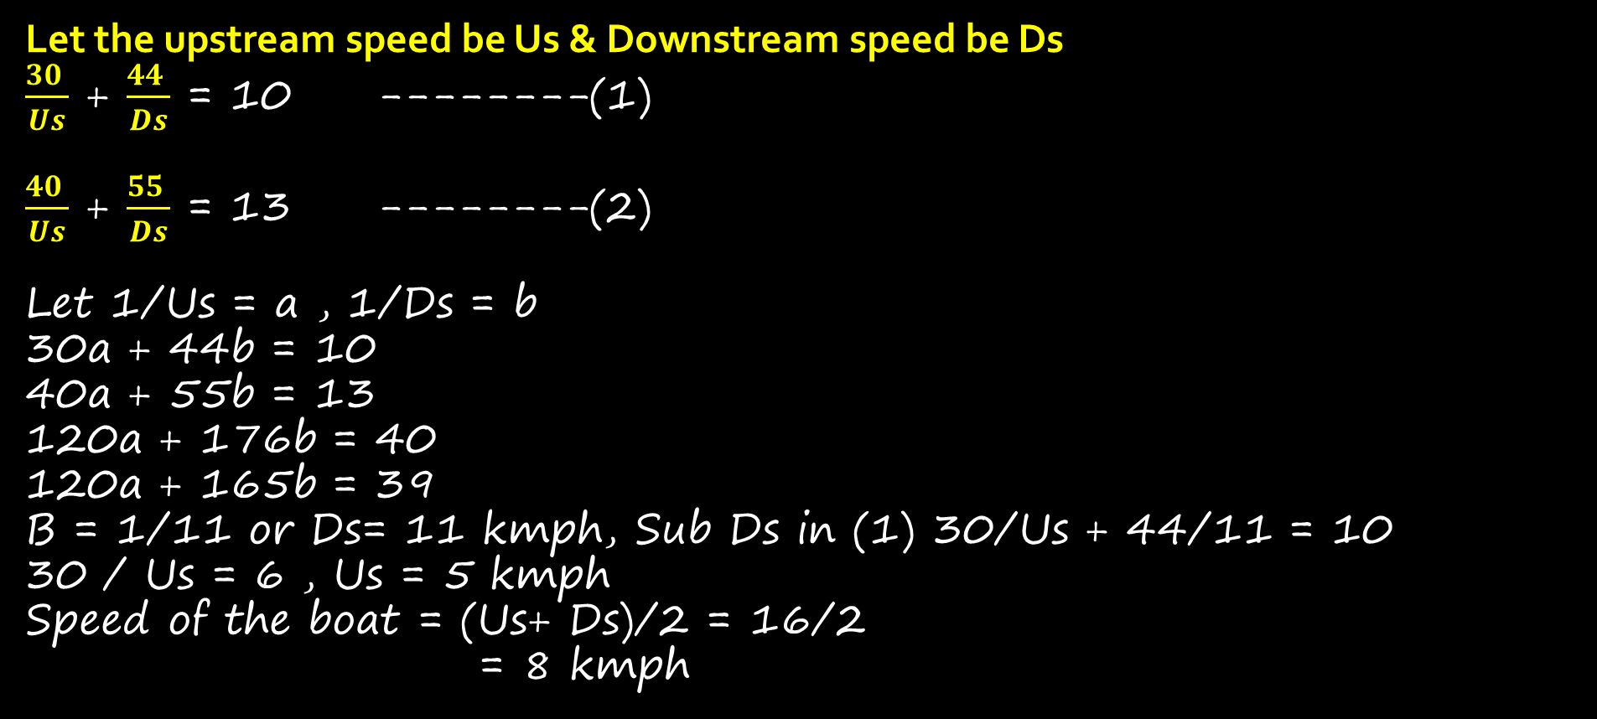
A boat goes 30 km upstream and 44 km downstream in 10 hours. In 13 hours, it can go 40 km upstream and 55 km downstream.The speed of the boat in still water is
A. 3 km/hour B. 4 km/hour C. 8 km/hour D. None of the above
Let the upstream speed be Us & Downstream speed be Ds
$\frac{30 }{Us}$ + $\frac{44 }{Ds}$ = 10 --------(1)
$\frac{40 }{Us}$ + $\frac{55 }{Ds}$ = 13 --------(2)
Let 1/Us = a , 1/Ds = b
30a + 44b = 10
40a + 55b = 13
120a + 176b = 40
120a + 165b = 39
B = 1/11 or Ds= 11 kmph, Sub Ds in (1) 30/Us + 44/11 = 10
30 / Us = 6 , Us = 5 kmph
Speed of the boat = (Us+ Ds)/2 = 16/2
= 8 kmph

Slide 36
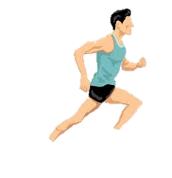
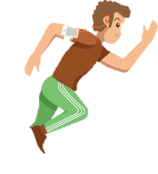
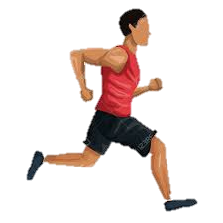
Topics to know to solve problems based on races:
Basic Ratio & Proportion Concepts
Time , speed and distance relation.
T ×S = D
Key terms used in Races.
Head Start ( A gives B a start of…), A beats B by.., Dead heat

Slide 37
Head-Start / A gives B start of x meters:
When a racer gets a start x meters ahead of the starting point it’s called head-start of x meters. Here A gives B a head-start of x meters.
For example: In a 100m race A gives B a head start of 20 meters means
When A covers 100m at the same time B will cover 80 meters.

Slide 38
A beats B by x meters
When A reaches the winning point before B and is x meters away from B. Then A beats B by x meters.
Example: In a 100m race A beats B by 20 meters means
When A covers 100m at the same time B will cover 80 meters.

Slide 39
Head-Start / A gives B start of t seconds:
When a contestant gets a start by t seconds earlier than other ones, it’s called head-start of t seconds. Here A gives B a head-start of t seconds.
Example: In a 100m race A gives B a head start of 5 seconds means
When A covers 100 meters in ‘t’ seconds B covers the same distance in ‘t+5’ seconds.

Slide 40
A beats B by t seconds:
When A reaches the winning point ‘t’ seconds before B. Then A beats B by ‘t’ seconds.
Example: In a 100m race A beats B by 5 seconds means When A covers 100 meters in ‘t’ seconds B covers the same distance in ‘t+5’ seconds.
Dead Heat:
When both A and B finishes the race at the same time .

Slide 41

A, B, C decides to run a 100 metres race. A beats B by 10 metres; B beats C by 20 metres; by how much distance will A beat C in a 600 metres race?
A beats B by 10 m = When A covers 100 B covers 100-10 = 90
So A:B = 100:90
B beats C by 20 m means When B covers 100m C covers 80 m
Same way B:C = 100: 80
We want A:C
So $\frac{ A}{B}×\frac{ B}{C}$ =$\frac{ A}{C}$
$\frac{100 ×100}{90 ×80}$ $=$ $\frac{100}{72}$
= When A covers 100 m C will cover 72m . A beats C by 28m in a 100 m Race so it beats C by 28*6 = 168 m in a 600 m Race.

Slide 42

A, B, C and D decides to run a 1800 metres race. A beats B by 360 metres; B beats C by 225 metres; D beats C by 400 metres. D beats A by how much distance?
A beats B by 360 m = When A covers 1800 B covers 1800-360 = 1440
So A:B = 1800:1440
Same way B:C = 1800: 1575
D:C = 1800: 1400
We want A:D
So $\frac{ A}{B}×\frac{ B}{C}$ $×$ $\frac{ C }{D }$ =$\frac{ A}{D}$
$\frac{1800 ×1800×1400}{1440 ×1575×1800}$ $=$ $\frac{10}{9}$ = $\frac{100}{90}$
$\frac{1000}{900}$ = $\frac{1800}{1680}$ Therefore A beats D by 180 m.

Slide 43
In a mile race, Akshay can be given a start of 128 m by Bhairav. If Bhairav can give Chinmay a start of 4 m in a 100 m dash, then who out of Akshay and Chinmay will win a race of one and half miles, and what will be the final lead given by the winner to the loser? One mile is 1,600 m.(CAT 2016)
Akshay: Bhairav = 1472:1600
Bhairav:Chinmayi = 100:96 = 1600: 1536
Akshay: Bhairav : Chinmayi = 1472:1600:1536
A:C = 1472:1536
= 736:768
= 184:192
= 46: 48
= 23:24
One and a half mile = 1600+800 = 2400 m
so 2300:2400
Chinmayi will beat Akshay by 100m.

Slide 44
In a 300 metres race A beats B by 22.5 metres or 6 seconds. A's time over the course is:
A beats B by 22.5 m or 6 seconds means
B(t)______22.5 m________A (t)
___________________B(t+6)
B takes 6 seconds to cover 22.5 m
it covers 45 m in 12 seconds ,
90 m in 24 seconds,
30 m in 8 seconds
and 300m in 80 seconds.
We know A beat B by 6 seconds
so A will take 74 seconds.

Slide 45

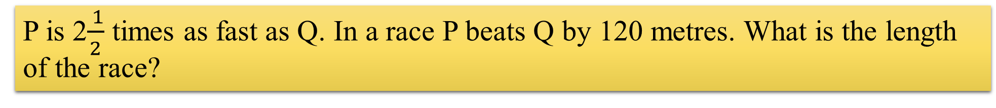
P is 2$\frac{ 1}{2}$ times as fast as Q. In a race P beats Q by 120 metres. What is the length of the race?
Let the length of the race = ‘d’
If Q speed is ‘S’ then P speed is ‘$\frac{ 5}{2 }$S’,
When P covers d meters then Q will cover d-120 for the same time.
Time = distance/ speed
$\frac{ d}{\left(\frac{5}{2}\right)s}$ = $\frac{ d−120}{s}$
2d= 5d-600
3d = 600
=>d=200m

Slide 46
Ram and Shyam participate in a race of 200m. If Ram starts when Shyam has covered 25 meters, then Ram finishes the race 10 seconds before Shyam and if Ram starts when Shyam has covered 45 meters then both finish the race at the same time. How long does Ram take to run 200m?
If Ram covers 200 m in ‘t’ seconds then Shyam will cover 175 m in ‘t+10’ seconds.
If Ram covers 200 m in ‘t’ seconds then Shyam will cover 155 m in ‘t’ seconds.
Shyam covers 20 m in 10 seconds so he will cover 200 m in 100 seconds.
But we want ram speed so we need to find shyam time to cover 175 m or 155 m to get ‘t’ value.
Speed of ram = 20/10 = 2 m/s. Time taken to cover 155m = distance/speed = 155/2
= 77.5 seconds. So that will be the time taken by Ram to cover 200m.

